Slide 1
Virginia VA-1 Conference October 5, 2010
Notes:
1
First time presenting during a General Session…main event. They say you never forget your first, but just to be sure, I’d like to get a quick photo. If everyone on this side of the room could stand up and move over here…that would be great. Very excited to be here. Thank you so much for having me/us. I want to cover a few topics today…1) Quick background and high level stats about TripAdvisor, 2) Best practices we’ve learned along the way, with regard to marketing your destination or business on Ta. 3) Some tips for how to best manage your reputation on TripAdvisor and dealing with “bad reviews”. 4) Quick overviews on a few of the latest ventures we’re focussing on at the company. Lots to cover, and I want to make sure I spend time on the most appropriate topics…quick show of hands, how many DMO folks here, Hoteliers, restaurants/attractions.

Slide 2
About TripAdvisor
TripAdvisor was founded in February 2000 as an unbiased resource to research and plan all aspects of travel.
Where to Go…
Where to Stay…
How to Get There…
What to Do When You Arrive

Slide 3
Our Mission
We help travelers
around the world plan & have the perfect trip.
Notes:
This has been the companies mission statement for 10 years. Contrary to some folk’s belief, the mission statement never included the phrase: “build a web platform that will empower users to make hotel managers feel like they just got punched in the stomach.”

Slide 4
Our Values & Philosophy
Travelers know everything:
We tap into their collective knowledge and enable the connection to share their experiences and advice
We are transparent – We do not edit or filter content
Bigger is better:
More opinions and more input surfaces relevant information
Freshness and speed of information provides the best consumer experience.
Notes:
Travelers know everythign: tap into their collective knowledge, get as many different opinions as possible so other travelers can use the information most appropriate for them to plan their perfect trip.

Slide 5
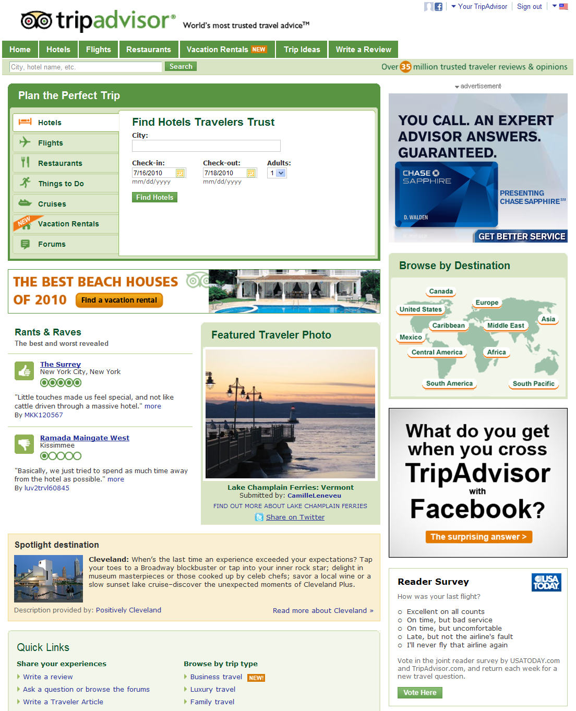
Our Content
TripAdvisor’s content:
Over 35 million unbiased reviews and opinions
Over 30,000 new reviews and opinions are created daily (21 per minute)
20 million+ registered members
By destination, we provide user reviews of:
71,528 Cities
462,723 Hotels
93,460 Attractions
581,272 Restaurants

Slide 6
Our Position in the Marketplace
We are the World’s largest… … travel website, online travel guide, global travel information provider and travel review resource.

Slide 7
Worldwide Readership
First travel website to surpass 40 million unique visitors in one month!
Notes:
More than 42MM unique visitors used TA in July to plan their upcoming trips. First travel site to do that….that’s more traffic than Travelocity, Orbitz and Priceline combined. Huge audience, but so what? Telling people how much traffic your website gets is kind of like bragging how much your car weighs. Who cares how much it weighs…if it can’t get you where you want to go. Well, most everyone in this room wants to get more people traveling to and within the state of VA.

Slide 8
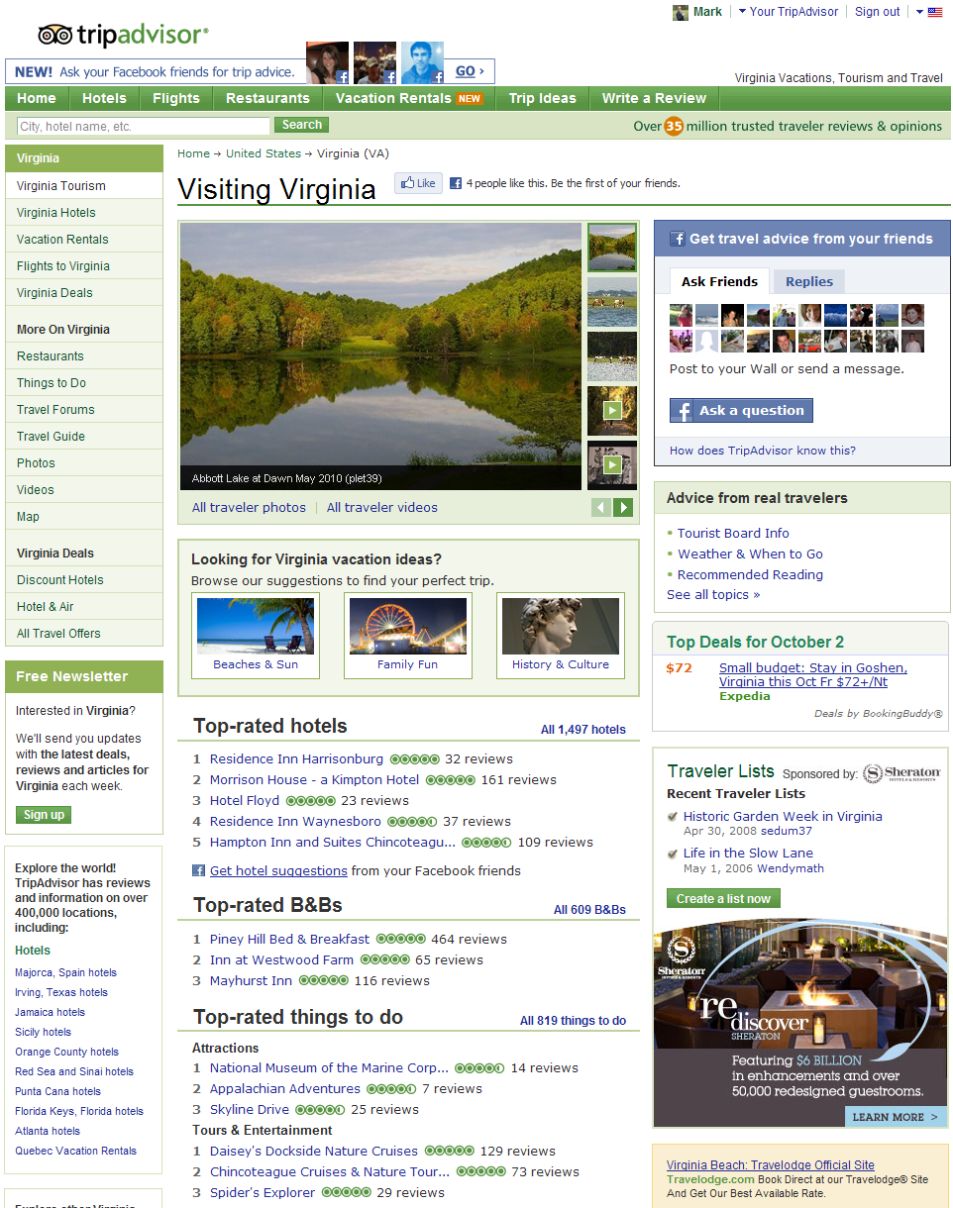
Virginia @ TripAdvisor
The Virginia channel on TripAdvisor
6.9MM Page views
3.4MM unique sessions
943,000 commerce clicks
Virginia content on TripAdvisor
2,106 Hotels & Accommodations reviewed
819 Things to Do
7,865 Restaurants
260 Destinations
8,107 topics discussed in the Virginia Forums
Notes:
Yes, we can help! Audience polls tell us 50% of the folks on TA use the site to help decide where they want to take their next trip – this is huge for DMOs. The other 50% already know where they are going, and use TA to figure out where to stay and what to do…which is huge for the hoteliers and attraction folks in the room.

Slide 9
Virginia @ TripAdvisor
Most Researched Virginia Destinations: July 2010
Virginia Beach
Williamsburg
Hot Springs
Charlottesville
Richmond
Chincoteague Island
Arlington
Alexandria
Norfolk
Roanoke

Slide 10
Marketing Opportunities on TA
Notes:
Over the past 2 weeks I’ve been to state tourism conferences for Florida and Colorado, and I spent 4 days in BC meeting wth a handful of DMO’s and their ad agencies. I’ve had more client meetings in a 2 week window than I can count, I’ve sat in General sessions and saw presentations from leading ad agencies, Google, Facebook, Gowalla…you name it. Through all of it, I’ve noticed 1 constant across all these meetings and conversations….1) it seems everyone’s marketing budgets are the largest they’ve ever seen. Just kidding, everyone’s strapped. Times like these you need to make the most efficient use of your marketing dollars.

Slide 11
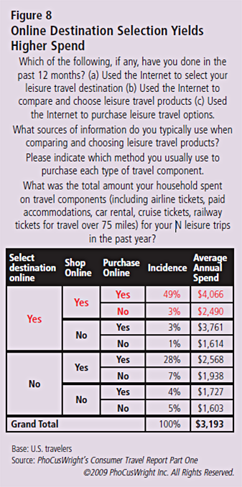
Fish Where the Fish Are
Travelers who select their destinations online and purchase their travel online spend, on average, 150% more on their annual travel than those travelers who do not.
Source:
PhoCusWright’s Destination Marketing: Understanding the Role and Impact of Destination Marketers May 2009
Notes:
When you get coca cola budgets, then go after everyone you want. When things are tight, you have to prioritize – spend your money where it will generate the highest return.

Slide 12
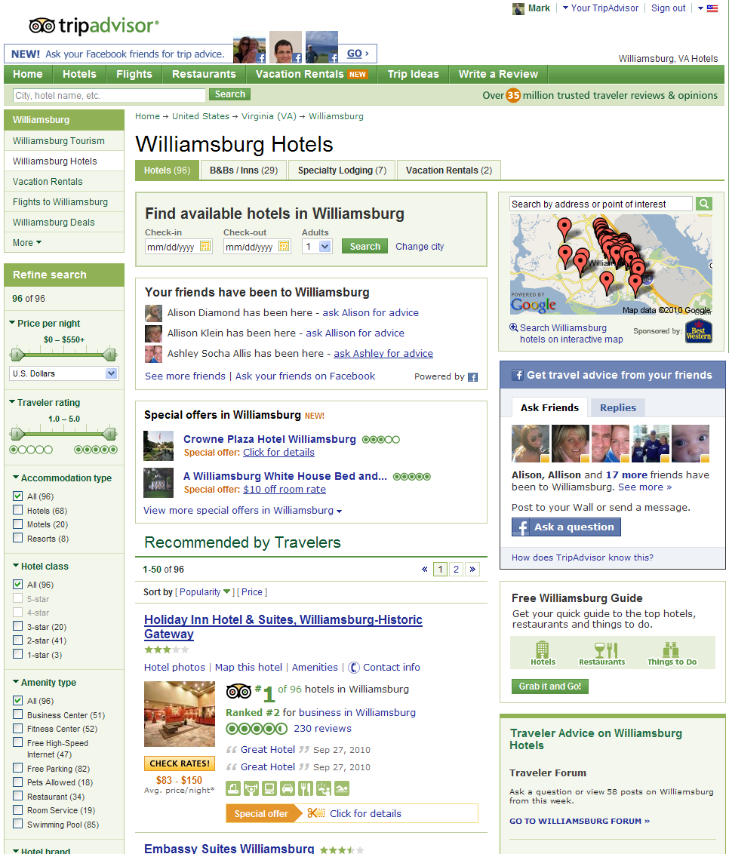
Targeted Banners
Pinpoint your Target Audience
Travelers actively researching travel throughout your area
Competitive destination marketing
IP-target feeder/drive markets
Placements
Standard IAB: 300x250, 728x90 and 160x600
Rich Media capabilities
Notes:
I’ve heard some presentations from some leading technology providers, and there’s some cool new marketing tools out there. But sometimes we can get caught up in the new shiney toys that we forget about some of the fundamentals. Close your eyes and picture a day in the future when technology could alert you everytime someone in the world started thinking about taking a trip somewhere. Like I mean, when you’re born, you get a chip planted in your brain that pumps brainwave activity into a marketing super computer and anytime someone started thinking about taking a trip, or even better, someone started thinking about taking a trip to Virginia, you could put your beautiful marketing message in front of those folks at that exact moment and start a dialogue with them. Oh wait, it exists now, its called a travel Website. The web is an engaged media channel, meaning you can’t passively surf the net. When you sit at your computer and do a google search for something, you are typing in that infomraiton because you want to know about it right now. I flip through magazines while I’m on a plane, or in a doctor’s office for entertainment or to pass the time, not to research an upcoming trip. I watch TV for news or entertainment. Never once have I had this conversation with my wife: “hey honey, where should we take our vacation this winter?” – I don’t know, why don’t you go watch House, and see if you get any good ideas.” The only reason why people are on TA is if they are thinkinga bout taking a trip somehwere – and you can message them. With an ad that has a pretty picture and animates or even video, and showcases a great deal to help pursuade them to book.” and its imbedded in the content that people are consuming, so they won’t get overlooked.

Slide 13
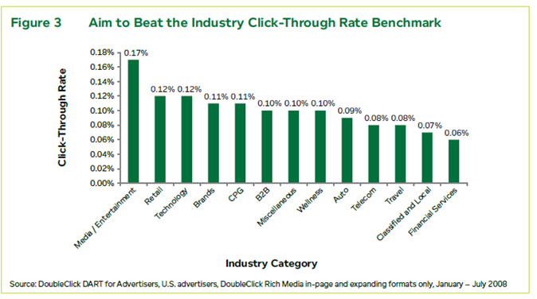
DART Statistics on Banner CTR
Notes:
100,000 people just saw my add – 100 clicks. Great, but what about the other 99,900 people that saw my add??

Slide 14
Banner Effectiveness
iProspect’s “Search Engine Marketing and Online Display Advertising Integration Study,” conducted by Forrester Consulting
“This study speaks to the power of display to drive search, and it demonstrates search’s ability to boost the effectiveness of display.”
More than half of internet users (52%) actively respond to display advertising on ad-supported websites
Internet users initially respond to online display advertising as follows:
27% respond by searching for the product, brand, or company by launching a search on a search engine.
21% respond by typing the company web address into their browser and directly navigating to the website.
9% respond by investigating the product, brand, or company through social media venues.

Slide 15
Purchase Funnel
Display works on all stages of the funnel
Advertisers who use display advertising to extend their reach beyond search receive the overwhelming majority of their conversions as a result of display advertising.
Search does not bring new prospects into the funnel but rather moves existing ones through
Source: “Eyeblaster- Search & Display: Reach Beyond the Keyword”… Published in February 2010

Slide 16
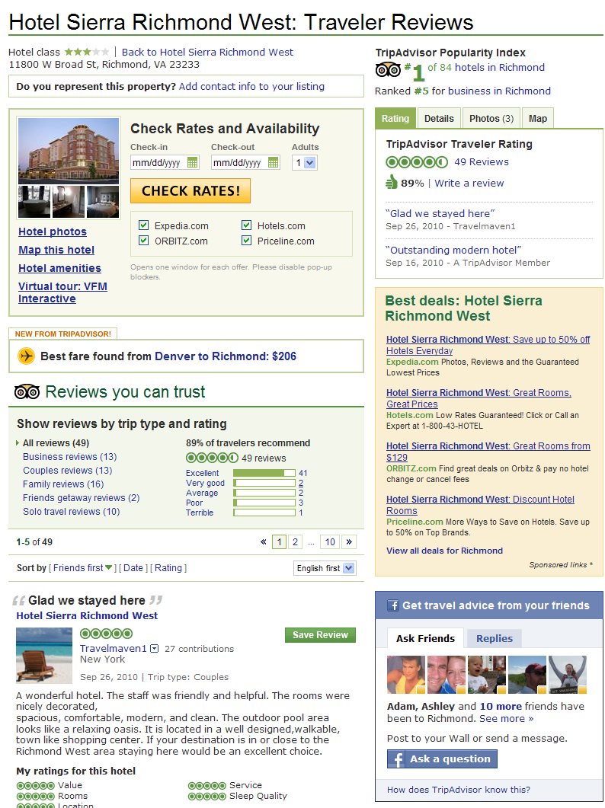
Beyond the Click
Commerce Links on TripAdvisor
Check Rates
Text Links
Case Study:
Targeted Banners to a pool of TA users who were researching the DMO’s surrounding area (not their destination)
Commerce Links within the DMO’s channel experienced an average 3% lift, when compared to readers not exposed to their banners
Virginia Channel Commerce Links
943,000 clicks in July 2010

Slide 17
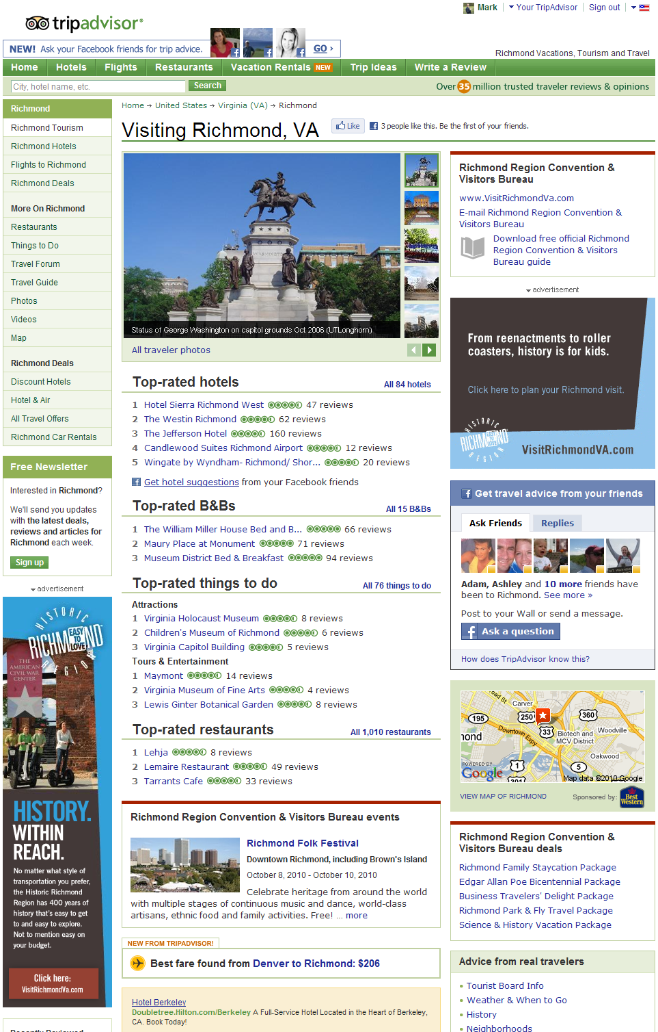
Tourism Sponsorship
The DMO Tourism Sponsorship is an annual subscription that allows a DMO to sponsor prime placements on their destination’s tourism page on TripAdvisor.
The modules will not only familiarize TripAdvisor users with great DMO content but will drive TripAdvisor users to the DMO’s site.
The Sponsorship includes:
DMO Photos & Videos
Links to DMO Websites and Email Address
DMO Brochure Link
Official Visitor Center(s) Flagged on Map
Promo Module
Events Module

Slide 18
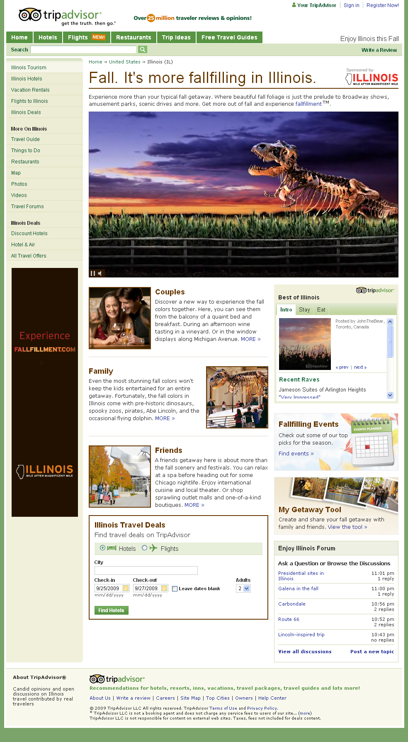
Travel Centers
TripAdvisor will work with each client to identify key objectives, and in turn, build a custom co-branded microsite, to drive audience engagement and interactivity.
Illinois Travel Center included:
Illinois’ fall-focused content based on getaway type
Promotions for Illinois events calendar and planning tool
Best of Illinois TripAdvisor content
TripAdvisor Travel Deals for Illinois
Feed to “Enjoy Illinois” forum

Slide 19
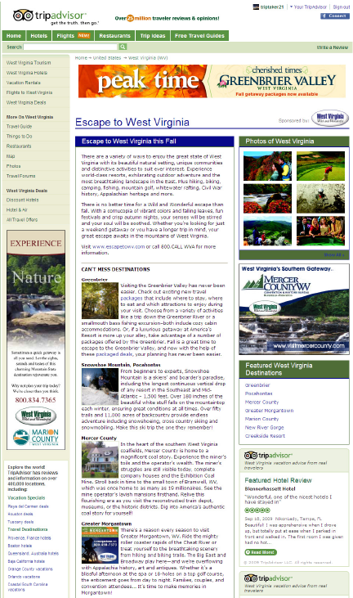
Co-Op Advertorial
Custom designed and built to meet the advertiser’s primary goals and objectives
Immerse Co-Op partners within premium content
Partner participation may include:
Editorial features
Text Links
Rotating Banners

Slide 20
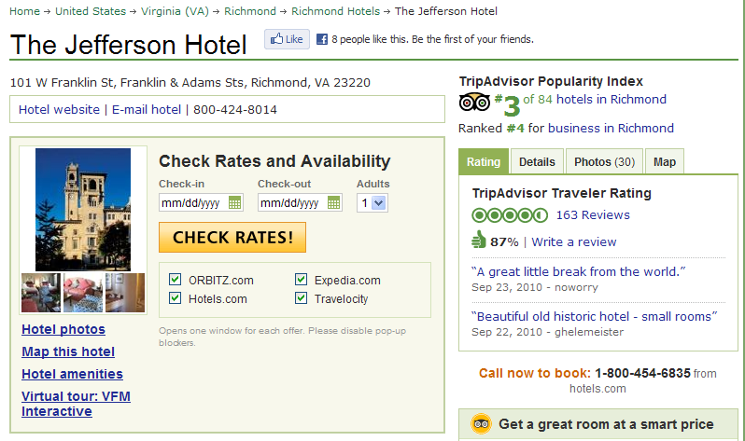
Business Listings

Slide 21
Business Listings

Slide 22
Business Listings

Slide 23
Reputation Management on TA

Slide 24
TripAdvisor Reviews
TripAdvisor reviews are largely positive
Average Score is 3.85
71% are 4+ stars

Slide 25
Fraud Squad
Fraud detection and enforcement
Very aggressive team
Screening every review
Automated fraud detection
Constantly evolving, learning
Absolutely confidential
Community, by nature, self-policing

Slide 26
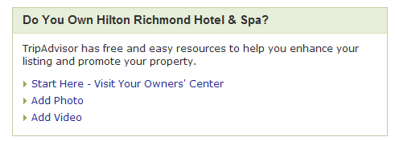
Owner’s Page, customized for each hotel: www.tripadvisor.com/owners Everything you need to manage your presence, and market your business

Slide 27
Owner’s Center Tools

Slide 28
Manage Your Listing

Slide 29
Manage Your Listing

Slide 30
Track Performance

Slide 31
Monitor Issues as they Arise

Slide 32
Statistical Distribution of Scores

Slide 33
Join the Conversation
You have control over customer reviews by providing clean facilities and excellent service.
If you stumble, as all hotels do from time to time, a well-written response to a negative comment is your strongest sales tool.
Neil Salerno, Hotel Marketing CoachTM

Slide 34
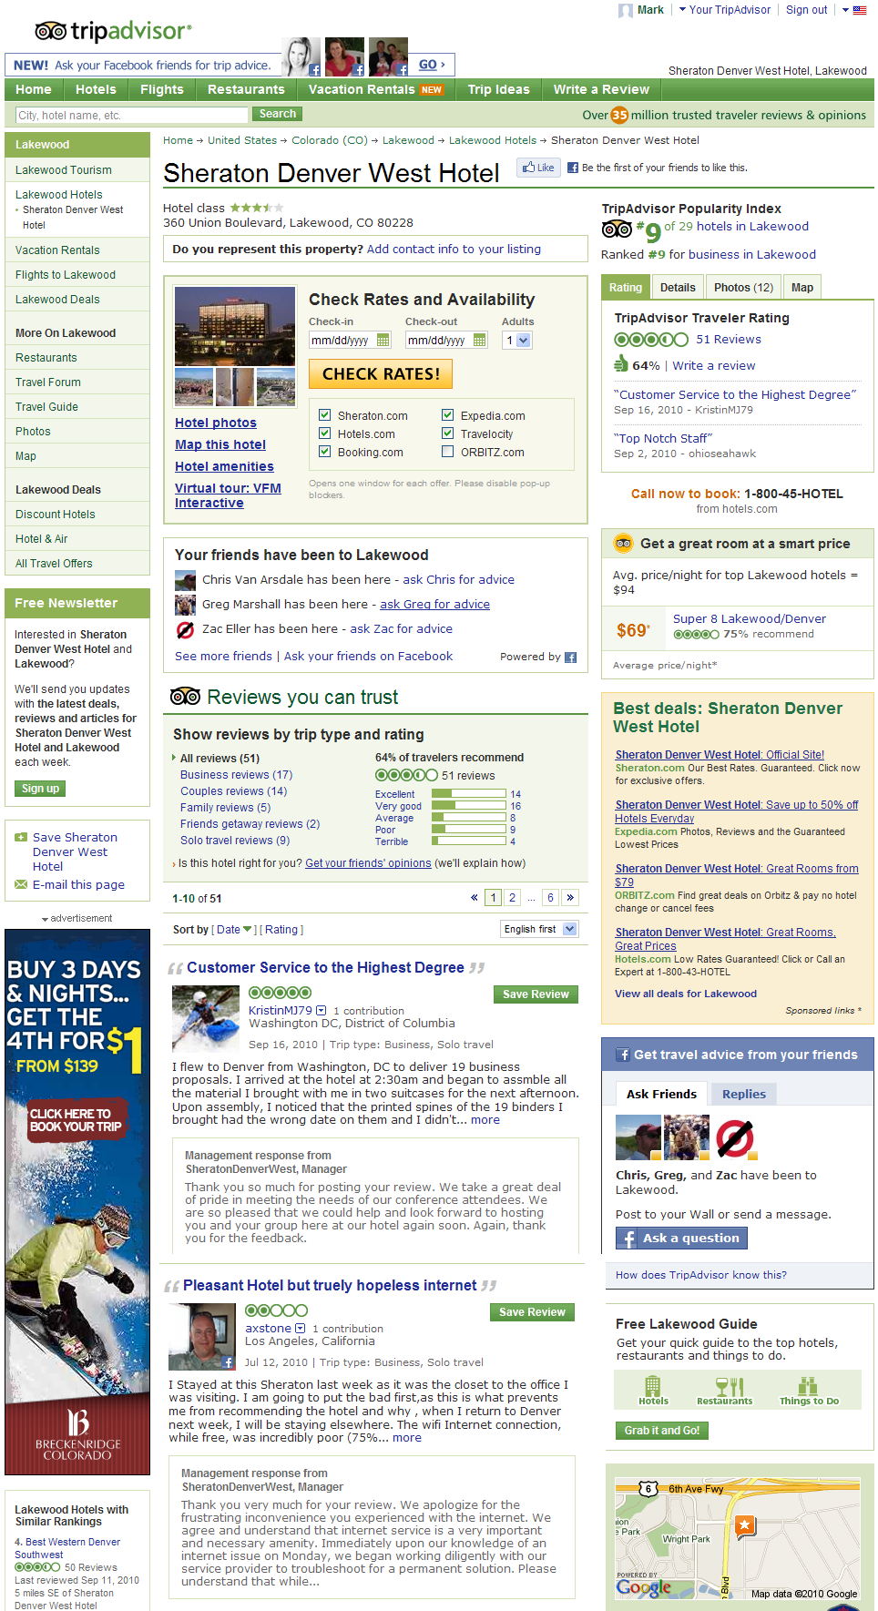
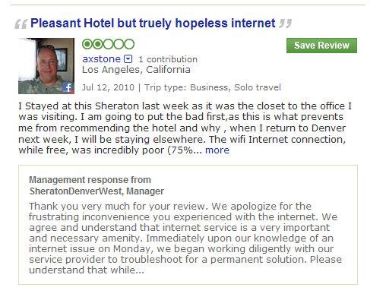
Management Response

Slide 35
Management Response Tips
Respond quickly
Keep the tone professional, whatever the concern
Avoid jargon
Highlight positive changes and updates
Be careful of individual privacy
Be original
Show gratitude

Slide 36
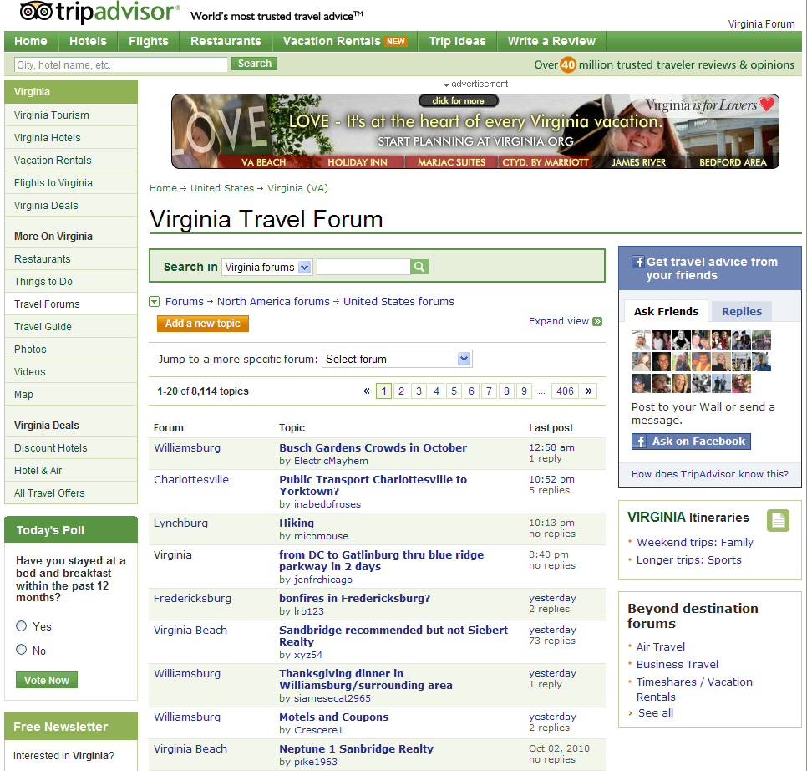
Join the Conversation: Forums

Slide 37
Put Your Ambassadors to Work
Ask them to write reviews
Send them emails with links

Slide 38
Not Okay
Attempts by an owner (or agents working on behalf of the ownership of a property) to boost the reputation of a property by:
Writing a review for their own property
Asking friends or relatives to write positive reviews
Submitting a review on behalf of a guest
Copying comment cards and submitting them as reviews
Pressuring a TripAdvisor member to remove a negative review
Offering incentives such as discounts, upgrades, or any special treatment in exchange for reviews
Hiring an optimization company, third party marketing organization, or anyone to submit false reviews
Impersonating a competitor or a guest in any way

Slide 40
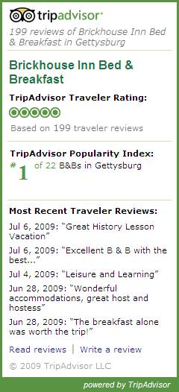
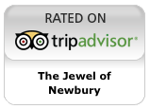
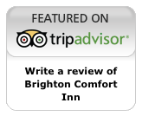
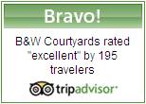
TA Content Distribution
Add reviews or badges to your web page in minutes
Put the reviews to work for you
More than 14,000 badges installed to date
Multiple badge types
Configurable review widget

Slide 41
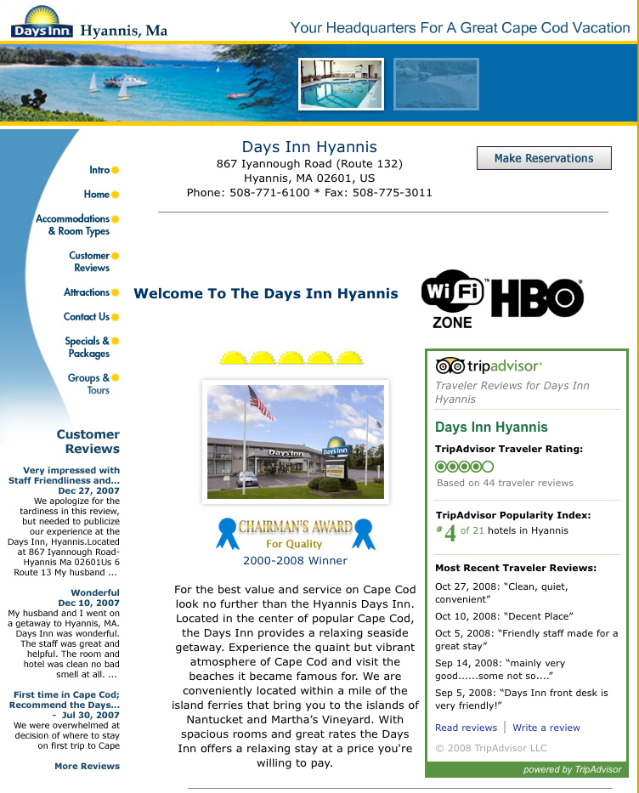
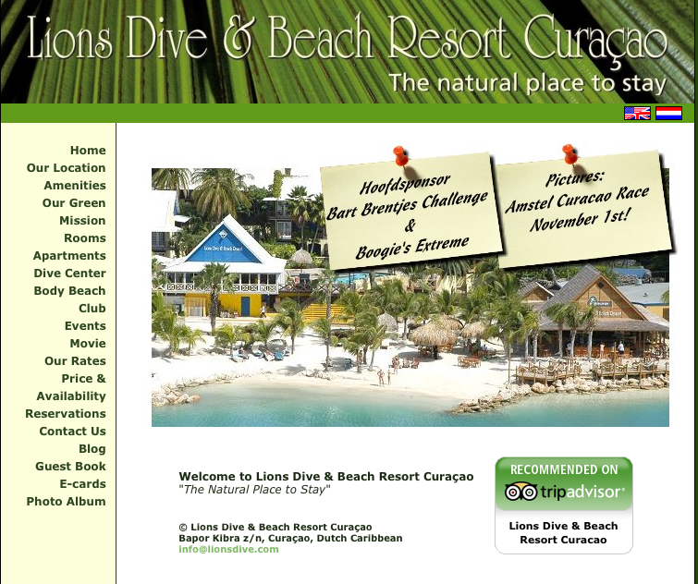
Widgets and Badges: User recommendations on your own pages

Slide 42
What’s New @ TripAdvisor

Slide 43
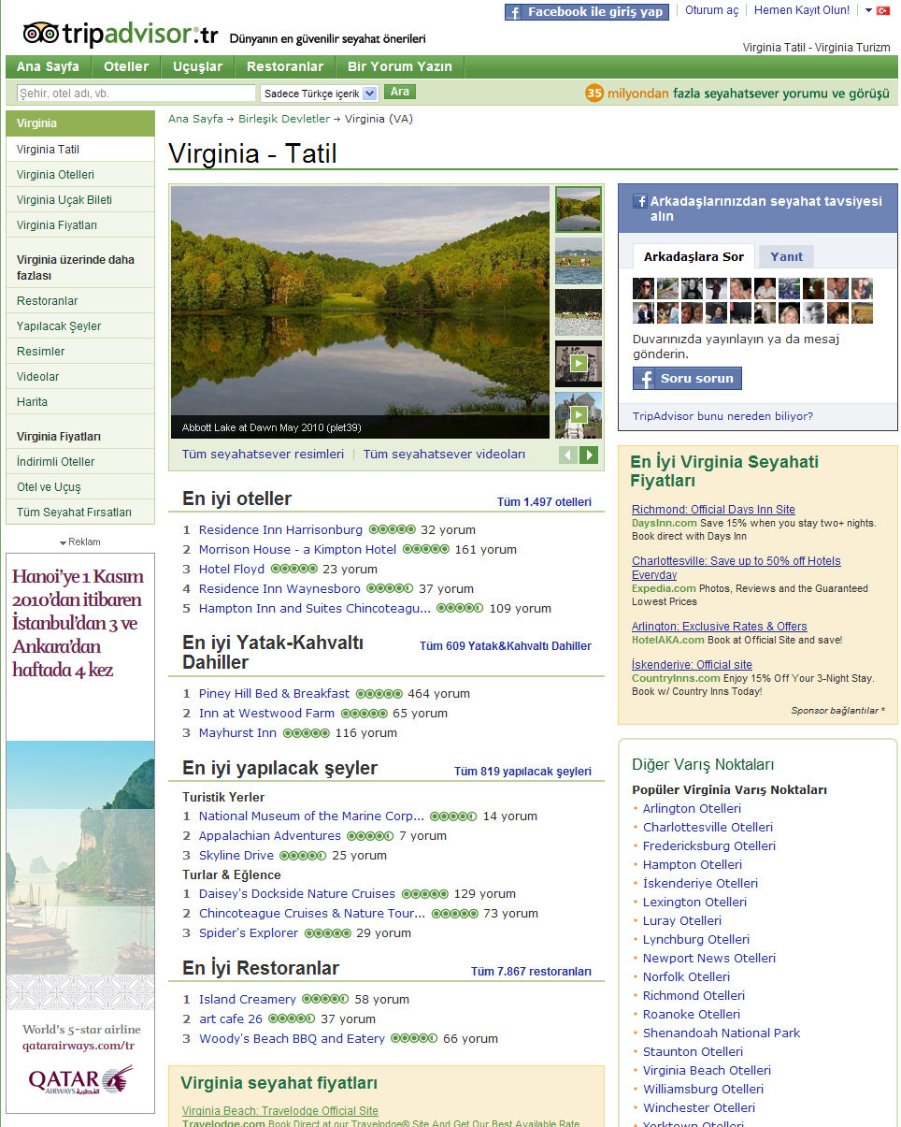
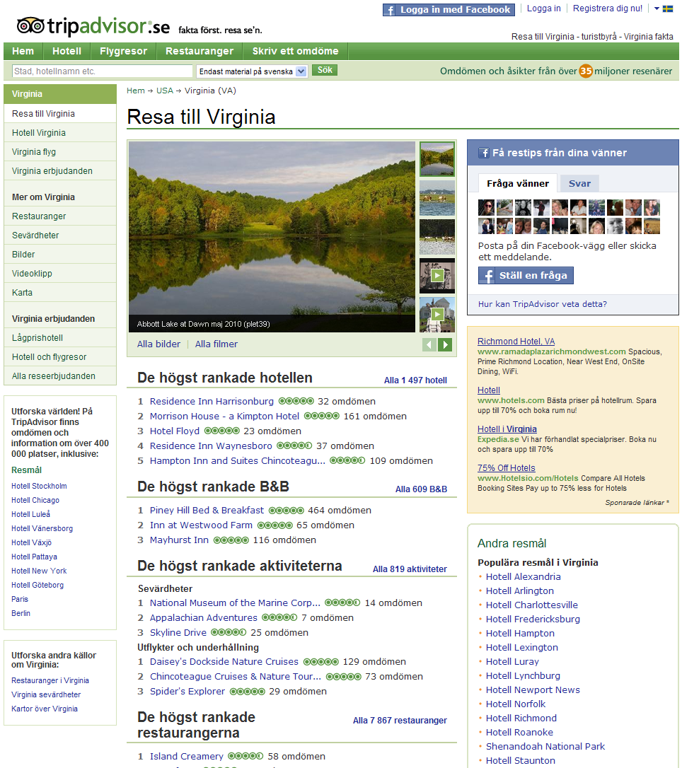
International Domains
23 International Domains
15 Languages

Slide 44
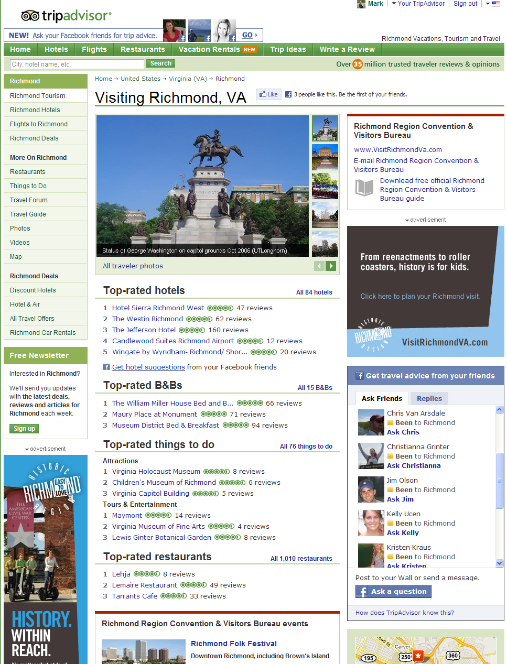
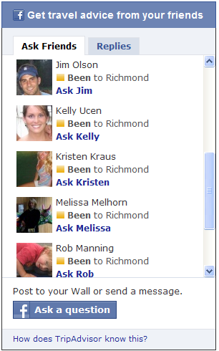
Facebook TripFriends

Slide 45
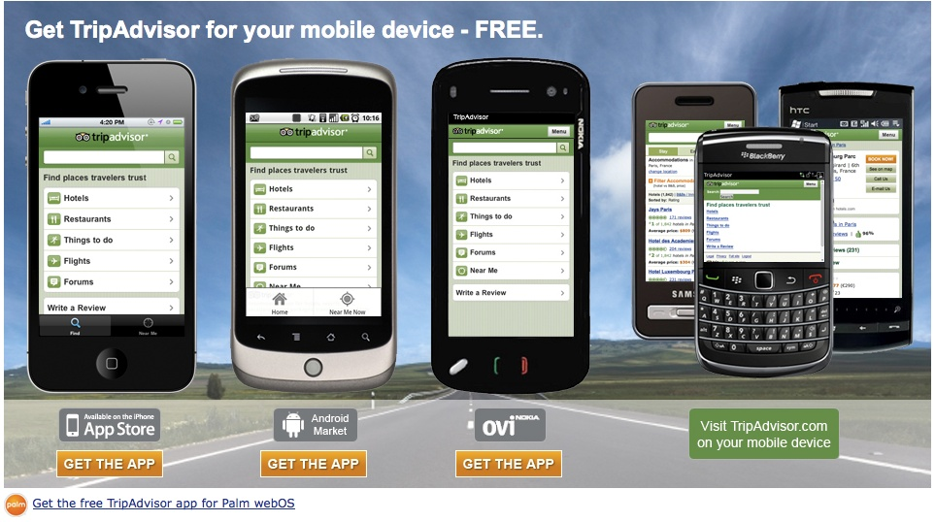
Mobile

Slide 46
Thank You.
Notes:
46

